Slide 1
Image to Website

Slide 2
Inspiration
Bolt
Lovable
Figma Make
=> Just WORSE(and local)

Slide 3
Original Plan
Get Image from User
With optional Prompt
Use Image-Modell to generate Prompt for Code-Modell
Generate first version of website
Take image of website using playwright or Selenium
Ask Image-Modell for possible improvements
Generate second version of website
Display result to the user

Slide 4
Corrected Plan
Get Image from User
With optional Prompt
Use Image-Modell to generate Prompt for Code-Modell
Generate first version of website
Take image of website using playwright or Selenium
Ask Image-Modell for possible improvements
Generate second version of website
5. Display result to the user

Slide 5
Factors of Procrastination
Lackluster Results
AI-Fatigue
"Side"-Projects
NotesChat

Slide 6
Technologies Used
Nuxt
Frontend
Backend
File based Storage
Proxy
Ollama

Slide 7
The Journey
Tool calls all the way
Try multiple models
Change Prompts (multiple times)
Maybe some without tools
Try more models
Change Prompts (multiple times)
Still unhappy

Slide 8
Lessons learned
There are reasons why companies exist that only do this
Prompt engineering is hard
Big models need hardware (=> Money)
Local-Models just not as good (at least the small ones)
The bigger the more reliable
Hallucination
Elements I did not specify
Too close to standard websites

Slide 9
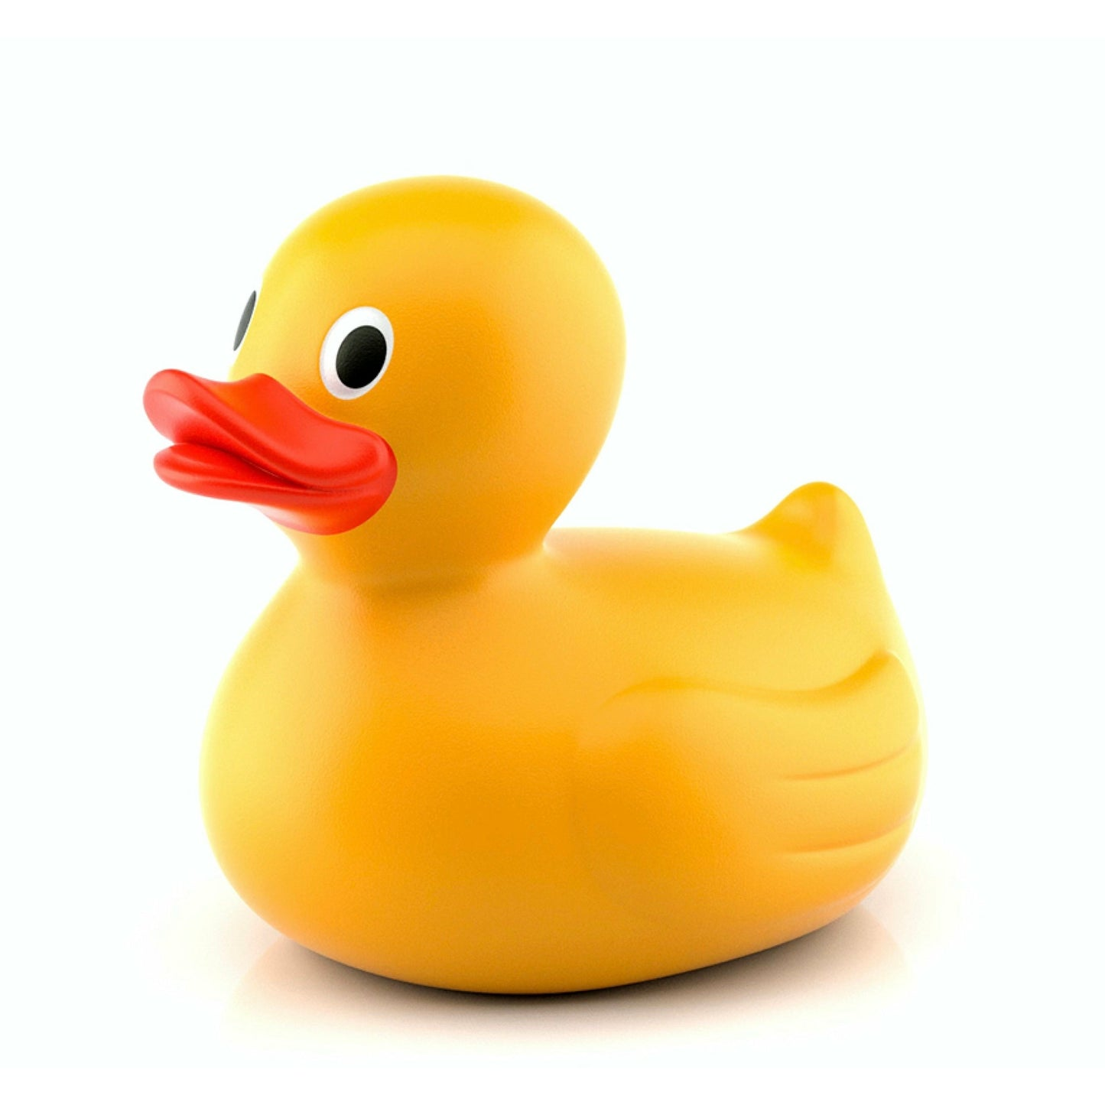

Slide 10
Tangent: NotesChat

